Slide 1
WRITE-UP OF RFM ANALYSIS

Slide 2
“SALES”

Slide 3
Why RFM analysis is important?
RFM analysis is a marketing technique used to quantitatively rank and group customers based on the recency, frequency, and monetary total of their recent transactions to identify the best customers and perform targeted marketing campaigns.
Recency: How recently has a customer made a purchase?
For example, If you buy something on 1st Jan. and today is 1st Feb., then the recency score is 30 days.
Frequency: How often do customers make a purchase?
This is the number of orders you made from your first purchase date.
If you buy a Shirt on 1st Jan. and Chinos on 15th Jan., then the frequency is 2 counts.
Monetary Value: How much money a customer spends on purchases?
Suppose you made two purchases. 1. Shirt is Rs. 500/-, and 2. Chinos is Rs. 1500/-
Then the monetary value is Rs. 2000/-
Customer segmentation is the practice of dividing a customer base into groups of individuals that are similar in specific ways relevant to marketing, such as age, gender, interests, and spending habits.

Slide 4
Customer Segmentation based on RFM score
Customer segmentation analysis is the process performed when looking to discover insights that define specific segments of customers. Marketers and brands leverage this process to determine what campaigns, offers, or products to leverage when communicating with specific segments.
Customer segmentation is the practice of dividing a company's customers into groups that reflect similarities among customers in each group. The goal of segmenting customers is to decide how to relate to customers in each segment in order to maximize the value of each customer to the business.

Slide 5
Steps to perform RFM analysis for each customer:
Calculate RFM Scores based on the RFM values:
We have calculated quartiles as shown in the right table. Now we need to assign scores to each interquartile range.
Minimum value (including) - 25% Percentile (excluding) : 1
25% Percentile (including) - 50% Percentile (excluding) : 2
50% Percentile (including) - 75% Percentile (excluding) : 3
75% Percentile (including) - Maximum Value (excluding) : 4
Above 75% - Maximum Value: 5

Slide 6
Customer Segmentation based on RFM score:
Recency:
Minimum to Maximum: 5, 4, 3, 2, 1
Note that we reversed the numbers for Recency because lower Recency is better for calculation. Frequency:
Minimum to Maximum: 1, 2, 3, 4, 5 Monetary values: Minimum to Maximum: 1, 2, 3, 4, 5

Slide 7
The Assumption with reasons:
1. Blank Customer IDs are removed
Blank customer IDs may be considered for fast check-outs. These customers are maybe not willing to identify with our company so we cannot assign these purchases to customers
2. Negative Values
These are highly impossible values, they may belong to customer returns or these may be store purchases/expenses and hence not considered.
3. Bad Debts
Bad debts are related to Losses and not related to Customer Segmentation
4. Interchange in RF Mapping sheet to get the exact category of customer segmentation

Slide 8
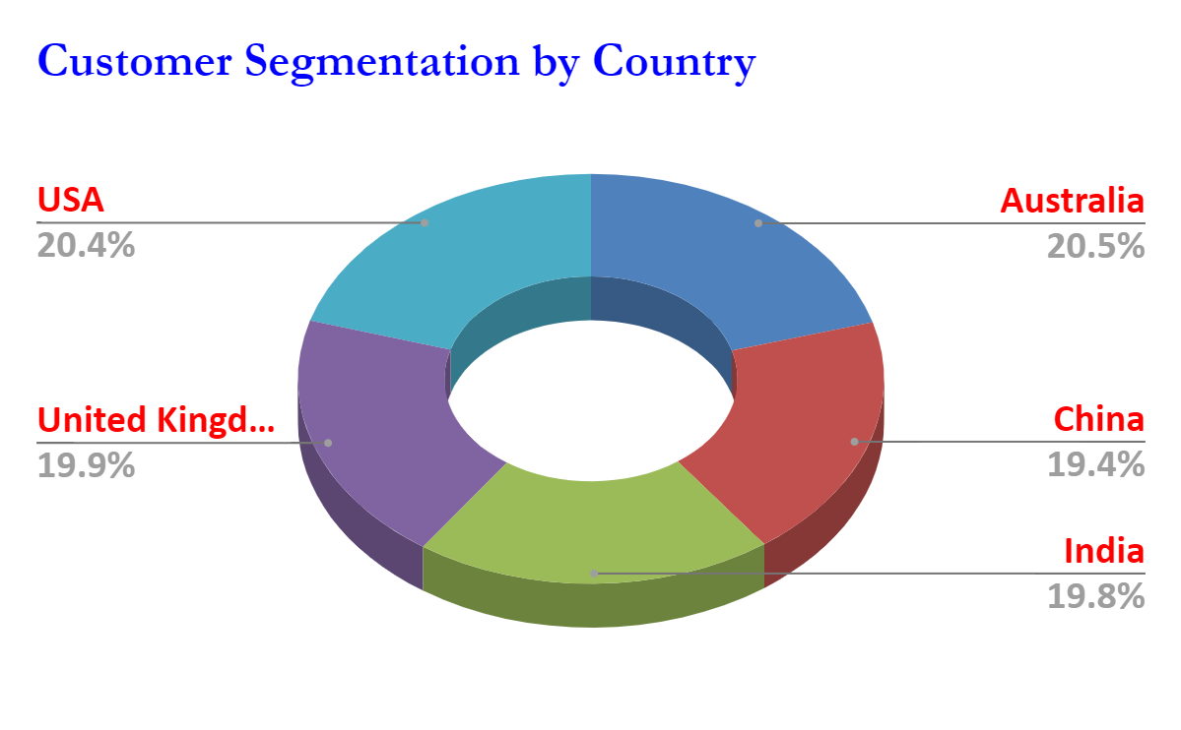
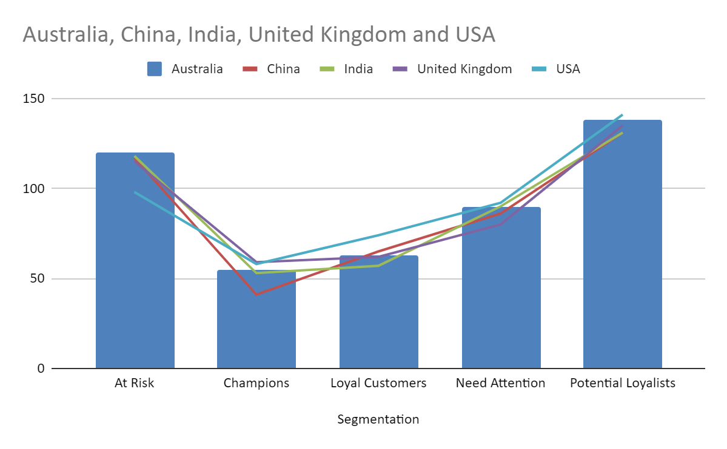

Slide 9
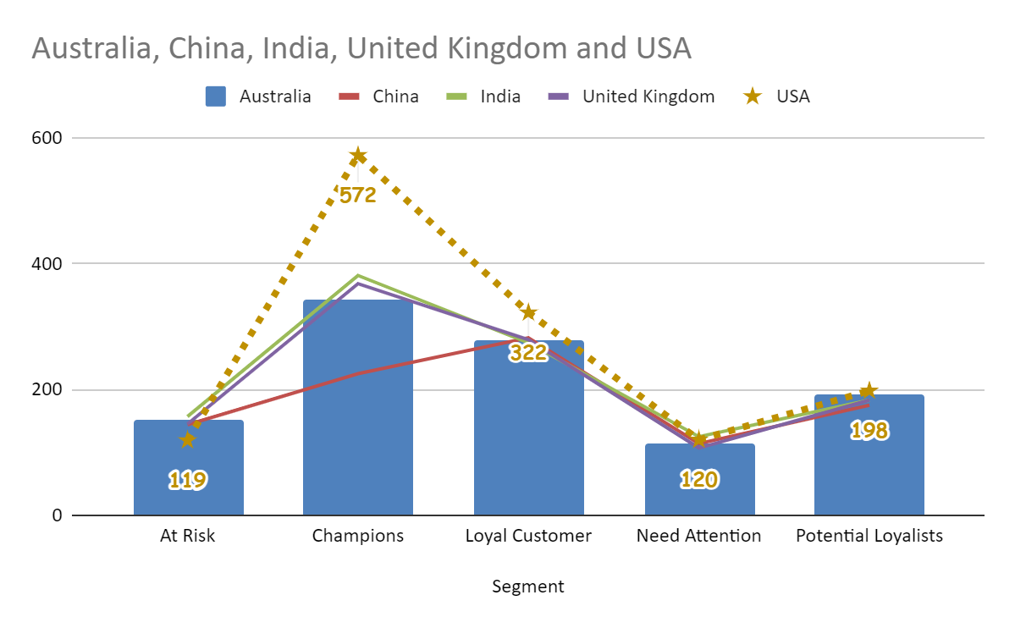

Slide 10
Customer Analysis
We have to analyze customer behavior so that company takes action plans according to that only to earn maximum profit in the market as per customer behavior which will help to target the best and most valuable customers through a campaign program. It will also help to provide attention to the customer as per their behavior.
We created a likewise customer analysis according to their customer ids, recency, frequency and monetary values. Based on this data we created customer segmentation.
CUSTOMER IS KING

Slide 11
THANK YOU!
By Rizwan Asif
Coding Invaders
Batch DA-45

